Slide 1

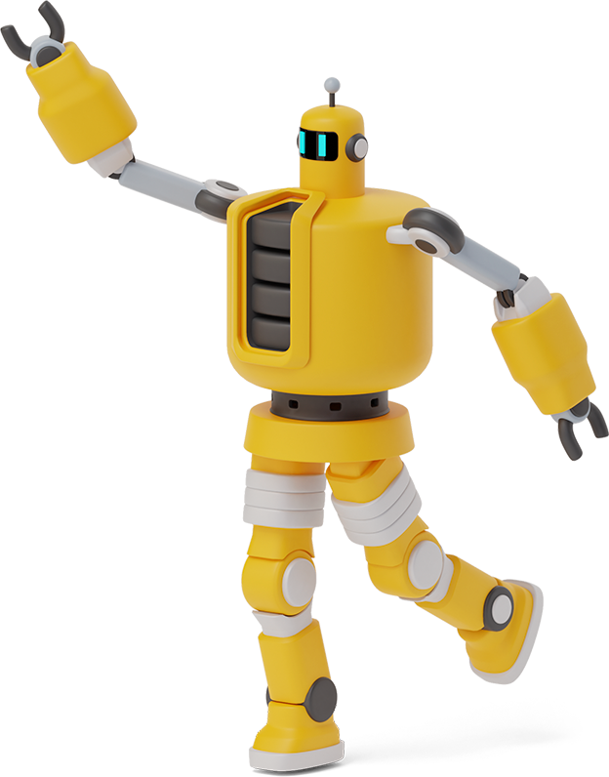
DATA TRANSMISSION WITH ERROR DETECTION

Slide 2
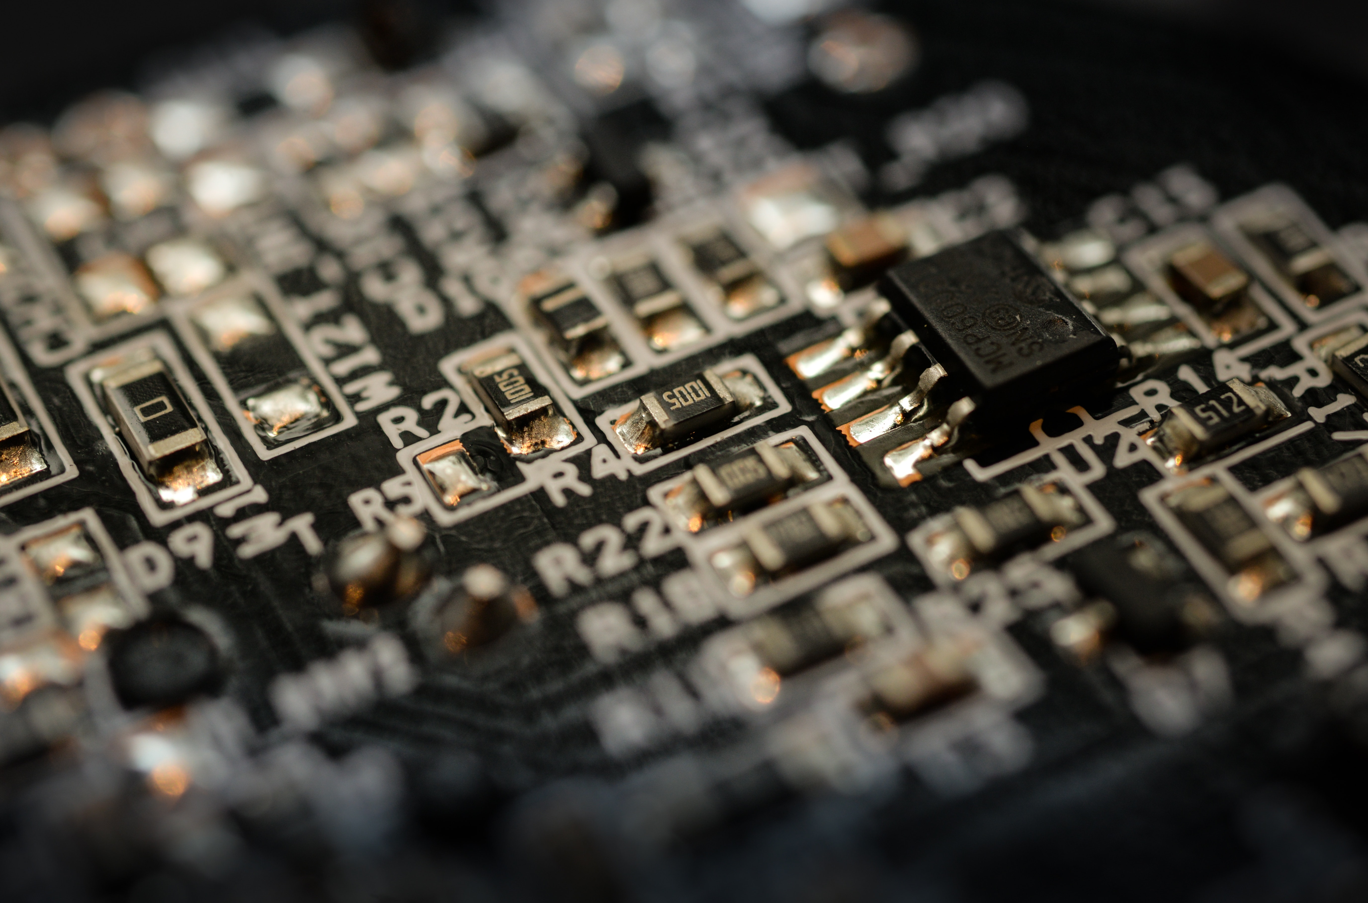
GROUP MEMBERS
Amna Jamshaid 2019-CE-09
Tanjeena 2019-CE-12
Laiba Ashiq 2019-CE-18
Aaiza Naeem 2019-CE-35

Slide 3
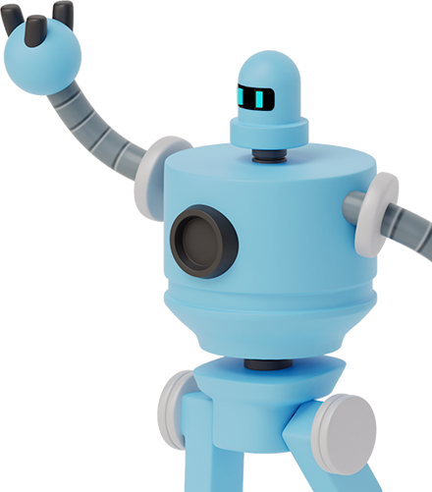
Objectives:
We will be able to deal with proteus.
Come to know about the data transmission system.
Able to deal with the different combinational logic units.
Learn that how the error will be detected and corrected.
Able to discuss on this topic.

Slide 4

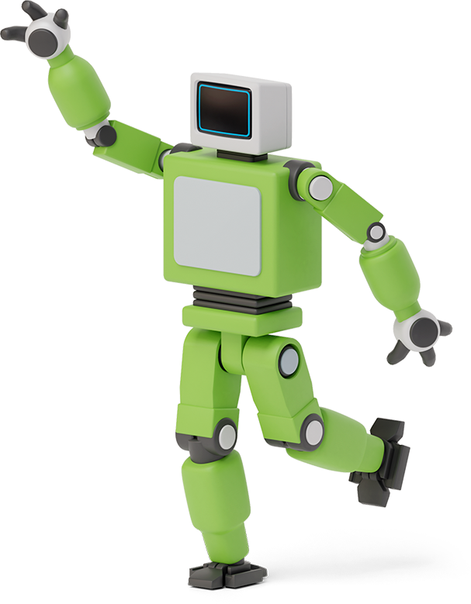
COMPONENTS IN USE:
1. MUX:
In the large-scale-digital systems, a single line is required to carry on two or more digital signals – and, of course! At a time, one signal can be placed on the one line. But, what is required is a device that will allow us to select; and, the signal we wish to place on a common line, such a circuit is referred to as multiplexer.
2. DE-MUX:
De-multiplexer is also a device with one input and multiple output lines. It is used to send a signal to one of the many devices. The main difference between a multiplexer and a de-multiplexer is that a multiplexer takes two or more signals and encodes them on a wire, whereas a de-multiplexer does reverse to what the multiplexer does.
3. Shift Register:
It is a group of
flip flops used to store multiple
bits of data. The bits stored in
such registers can be made to
move within the registers and
in/out of the registers by applying
Clock pulses.
4. A parity generator:
It is a combinational logic circuit that
generates the parity bit in the
transmitter. On the other hand,
a circuit that checks the parity in
the receiver is called parity checker.
A combined circuit or devices of
parity generators and parity checkers
are commonly used in digital systems
to detect the single bit errors in the
transmitted data word.
5. Logic gates:
They are the basic building blocks
of any digital system. It is an electronic circuit having one
or more than one input and only
one output.
6. IC’S:
74151 IC of mux
74HC138 IC of de-mux
74199 IC of shift register

Slide 5
BLOCK DIAGRAM:
Error Detection Process

Slide 6
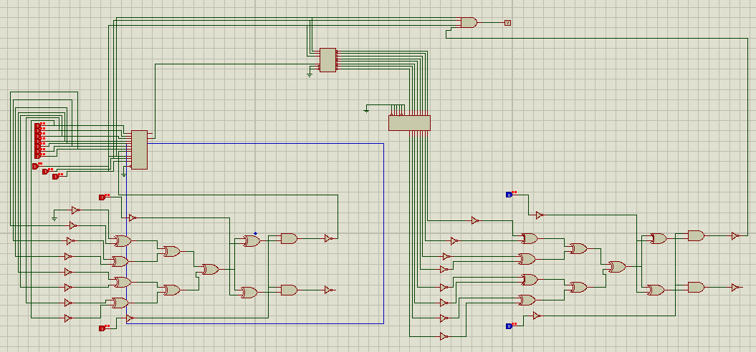
CIRCUIT diagram :

Slide 7
Thank you ☺

